Slide 1

Navigating the
Waters: Understanding Flood Risk in
Sevierville
A Visual Guide Powered by FEMA and US Census Data

Slide 2
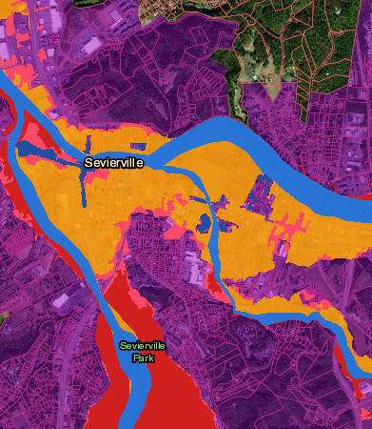
Steps
Took a basic map of Sevierville town and started creating layers on it for relevant data.
Imported a vector layer to find GIS links along the areas around the Sevierville to define the boundary and study area.
Imported a vector layer to show Flood way in blue color using FEMA dataset on the website to show the way of flood towards the prone areas.
Inserted flood categories (Red, Pink, Dark Blue) to show the areas that can be affected badly and have a high chance of flooding around the water areas. This data is based on the US Census dataset.
Imported a vector layer in Orange color to show Flood data of the affected areas over the last 100 years in the way of water flowing.
Imported a vector layer to show city limits in already created flood disaster map to show the city boundaries.

Slide 3
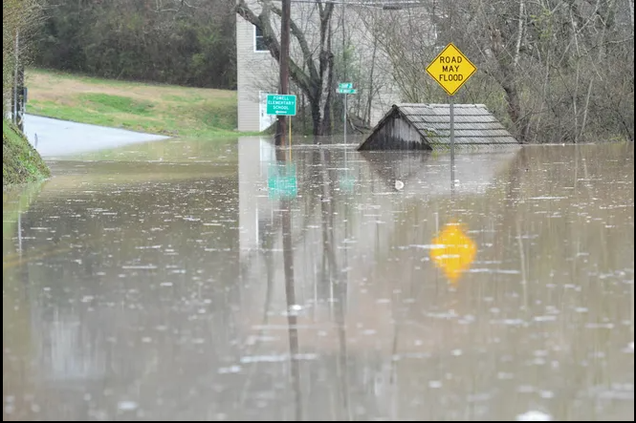
The Looming Threat
Sevierville faces multiple flood risks, including riverine floods, flash floods, and urban flooding.
There had been 6 times flooding in the Sevierville

Slide 4
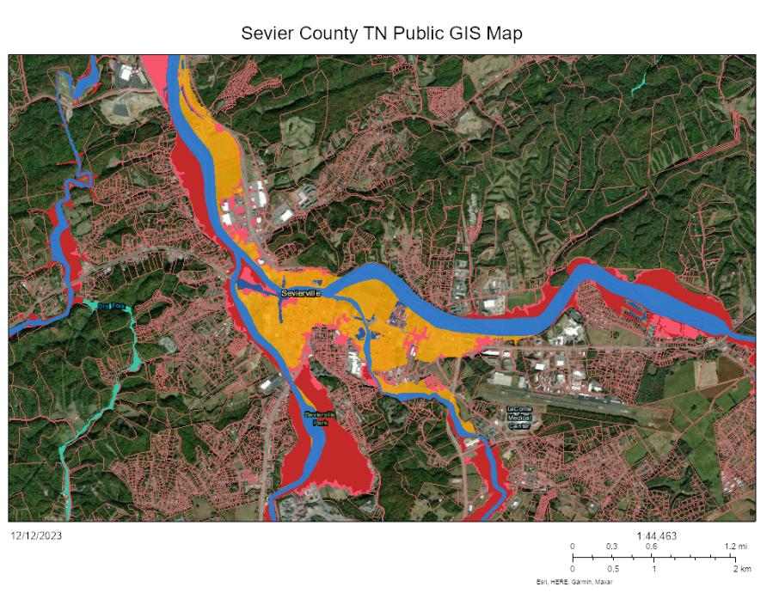
UNMASKING THE LANDSCAPE OF FINAL MAP

Slide 5
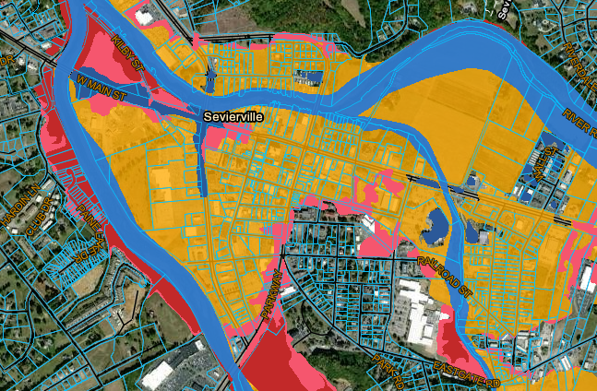
Zooming In
From High-risk (Deep Red) to Low risk (Light Blue) areas, explaining the prone areas to the flood.

Slide 6
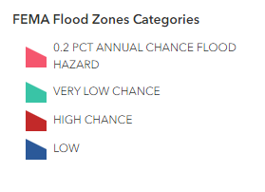
Categories Used
These are categories used to explain the different areas in the map determining the intensity of flood prone areas.

Slide 7
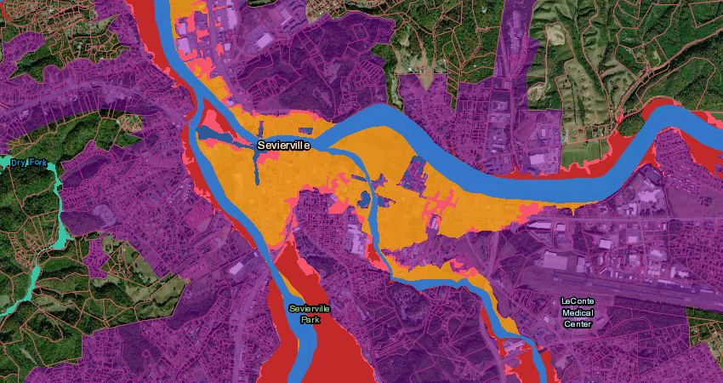
Describing the
City Limits
The Purple area in the map points to the town limits of Sevierville to be considered for flooding.

Slide 8
Data Sources Used
FEMA Flood Data
US Census Data
USGA Data for Sevierville

Slide 9

Assumptions:
Data Accuracy and Completeness: The accuracy and completeness of the datasets used (FEMA Floodplain Map, US Census data, USGA data, etc.) are accurate and reliable.
Data Compatibility: The datasets can be easily converted to compatible formats and integrated within QGIS for analysis.
Data Representativeness: The datasets accurately represent current conditions and trends in Sevierville.
Chosen Methods: The chosen methods for data analysis, visualization, and map creation are appropriate and effective for the project goals.
Symbology and Labeling Choices: The chosen symbology and labeling effectively represent the data and are clear and understandable for users.
Spatial Analysis Techniques: The chosen spatial analysis techniques are appropriate for identifying vulnerable areas and potential risk hotspots.

Slide 10

Offer child care.
Help parents out by watching their kids.

